Slide 1
Distillation Process
B. K. Birla College, Kalyan
Department of Chemistry
Dr. Vilas Khairnar
Instructional Designing
Principle, Apparatus, Procedure & Applications

Slide 2
Learning Outcomes
Define distillation
Differentiate simple & fractional distillation
Identify apparatus
Explain procedure
Apply concepts

Slide 3
Prerequisite Knowledge
Boiling point
Vapor pressure
Phase changes

Slide 4
Introduction
How can two miscible liquids be separated?
Examples: Water purification, Petroleum refining

Slide 5
Definition
Distillation is a separation technique based on differences in boiling points.

Slide 6
Principle
Liquid → Vapor → Condensation
Separation based on volatility

Slide 7
Types of Distillation
Simple Distillation
Fractional Distillation

Slide 8
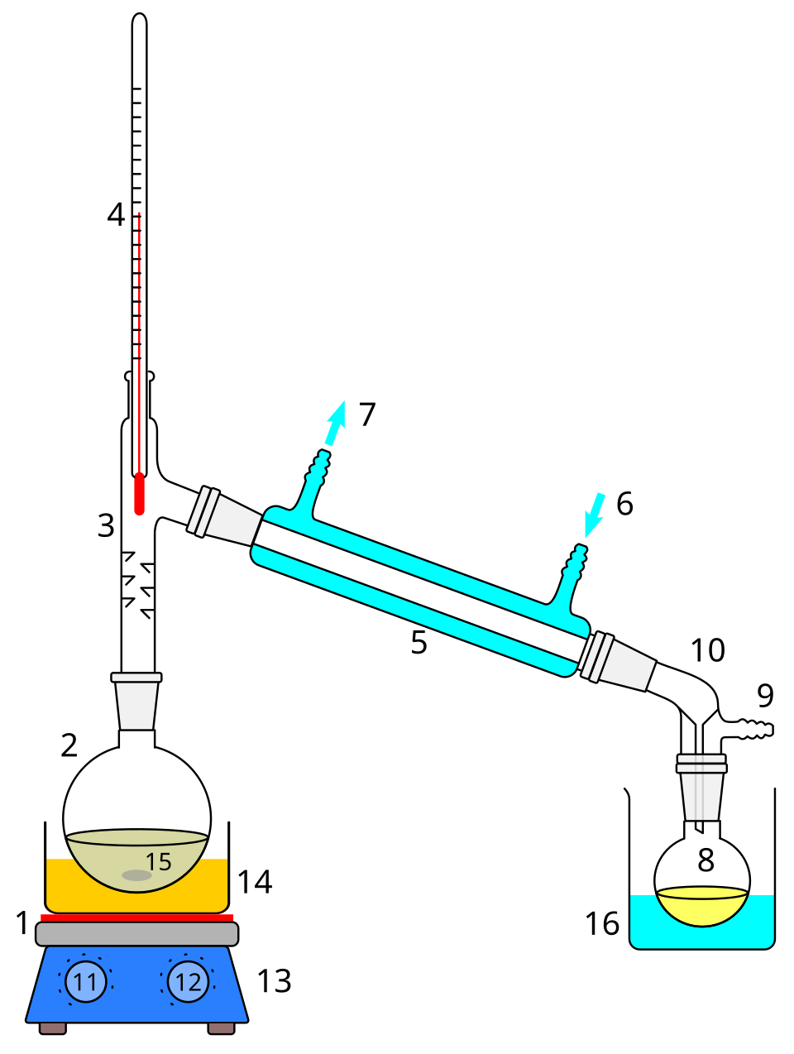
Apparatus – Simple Distillation
Flask, Thermometer, Condenser, Receiver

Slide 9
Apparatus – Fractional Distillation
Fractionating column improves separation

Slide 10
Procedure
1. Heat mixture
2. Vaporization
3. Condensation
4. Collection

Slide 11
Observations
Temperature recorded
Purity of distillate

Slide 12
Applications
Laboratory purification
Petroleum refining
Pharmaceutical industry

Slide 13
Safety Precautions
Avoid closed systems
Ensure condenser water flow

Slide 14
Assessment
MCQs
Diagram labeling
Short answers

Slide 15
Learning Outcome Mapping
Outcome → Activity → Assessment

Slide 16
Recap
Key takeaways
Reflection question

Slide 17
Extension Activity
Virtual lab
Industrial case study

Slide 18
THANK YOU

